Slide 1

Heart Disease Prediction

Slide 2
TEAM MEMBERS :
Palak Sharma (RA1911033010112)
Shivang Bhatnagar (RA1911033010119)
Siddharth Bansal (RA1911033010123)

Slide 3
ABSTRACT
In this project, we will be closely working with the heart disease prediction and for that, we will be looking into the heart disease dataset. From that dataset we will derive various insights that help us know the weightage of each feature and how they are interrelated to each other.
But this time our sole aim is to detect the probability of person that will be affected by a severe heart problem or not.

Slide 4

OBJECTIVE
Our objective is to predict the heart disease with the help of a logistic regression model.
The correct prediction of heart disease can prevent life threats, and incorrect prediction can prove to be fatal at the same time.

Slide 5
PROBLEM STATEMENT
World Health Organization has estimated 12 million deaths occur worldwide, every year due to Heart diseases. Half the deaths in the United States and other developed countries are due to cardiovascular diseases. The early prognosis of cardiovascular diseases can aid in making decisions on lifestyle changes in high risk patients and in turn reduce the complications. This research intends to pinpoint the most relevant/risk factors of heart disease as well as predict the overall risk using logistic regression.

Slide 6
METHODOLOGY
The classification goal is to predict whether the patient has 10-year risk of future coronary heart disease (CHD).
We have implemented Logistic Regression Model to predict Coronary Heart Disease.
What is Logistic Regression ?
Logistic Regression is a statistical and machine-learning techniques classifying records of a dataset based on the values of the input fields . It predicts a dependent variable based on one or more set of independent variables to predict outcomes . It can be used both for binary classification and multi-class classification.

Slide 7
DATA SET
Attributes which are used are:
sex: male or female
age: age of the patient
education: levels coded 1 for some high school, 2 for a high school diploma or GED, 3 for some college or vocational school, and 4 for a college degree.
currentSmoker: whether or not the patient is a current smoker
cigsPerDay: the number of cigarettes that the person smoked on average in one day.

Slide 8
6. BPMeds: whether or not the patient was on blood pressure medication
7. prevalentStroke: whether or not the patient had previously had a stroke
8. prevalentHyp: whether or not the patient was hypertensive
9. diabetes: whether or not the patient had diabetes
10. totChol: total cholesterol level
11. sysBP: systolic blood pressure

Slide 9
12. diaBP: diastolic blood pressure
13. BMI: Body Mass Index
14. Heart rate: heart rate
15. glucose: glucose level
16. TenYearCHD: 10 year risk of coronary heart disease CHD (TARGET
VARIABLE

Slide 10
WHAT WE DO
1 Importing the required libraries.
2. Importing and Reading the dataset.
3. Exploratory Data Analysis (EDA)
4. Data-Preprocessing
5. Data Visualization
Correlation Matrix
Pairplot
Countplots

Slide 11
6. Data Modeling
Separating the data into features and target variable.
Splitting the data into training and test sets.
Modeling/ Training the data
Predicting the data
Calculating the prediction scores
Getting the model's accuracy
Classification Report
Confusion Matrix
Plotting the confusion matrix

Slide 12
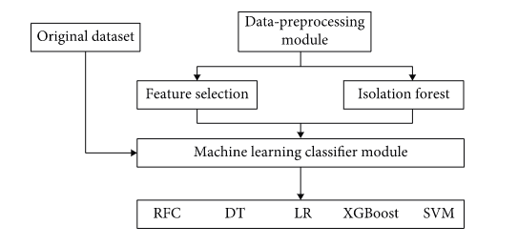
DIAGRAMMATIC REPRESENTATION

Slide 13
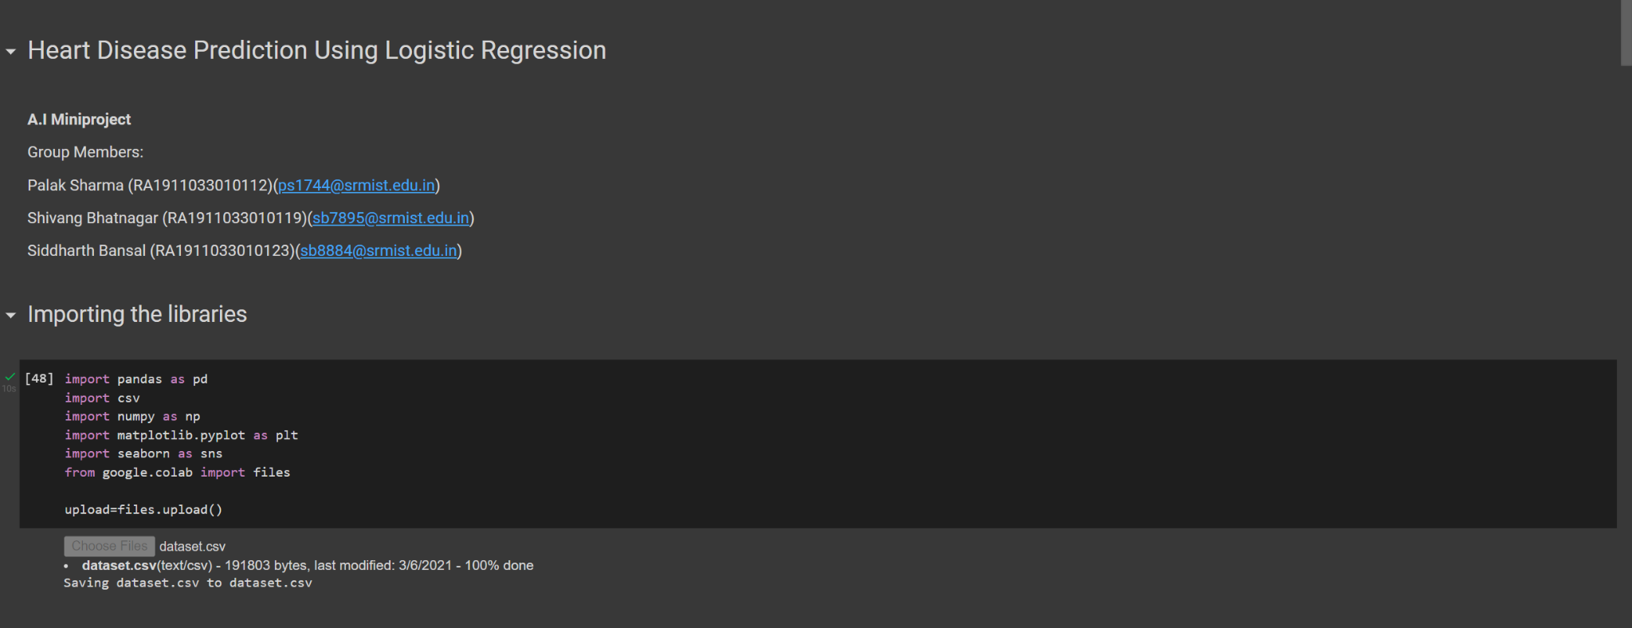
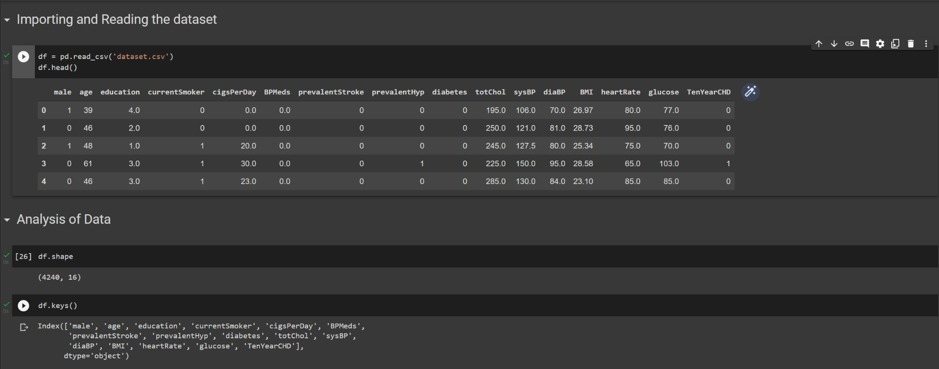

Slide 14
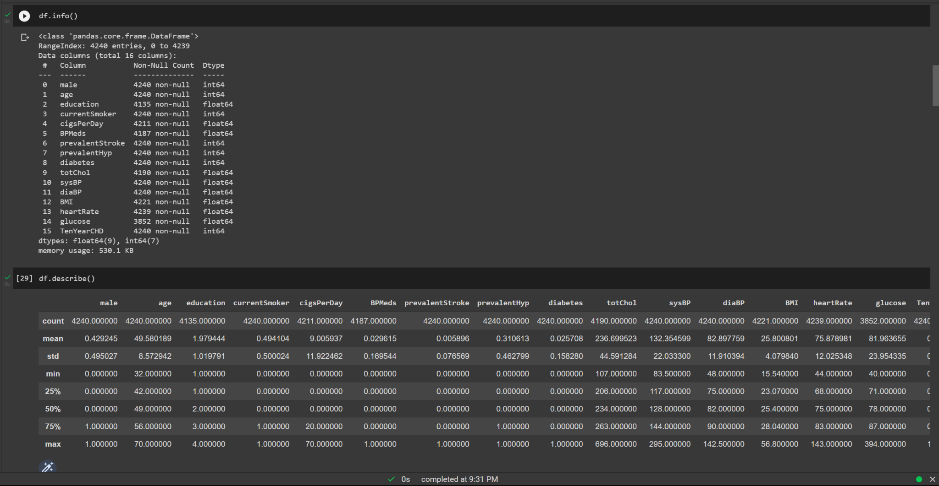

Slide 15
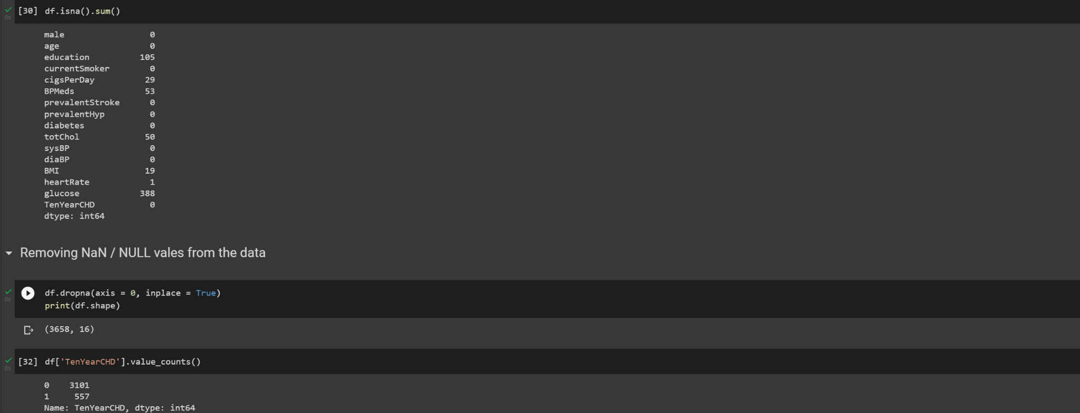

Slide 16
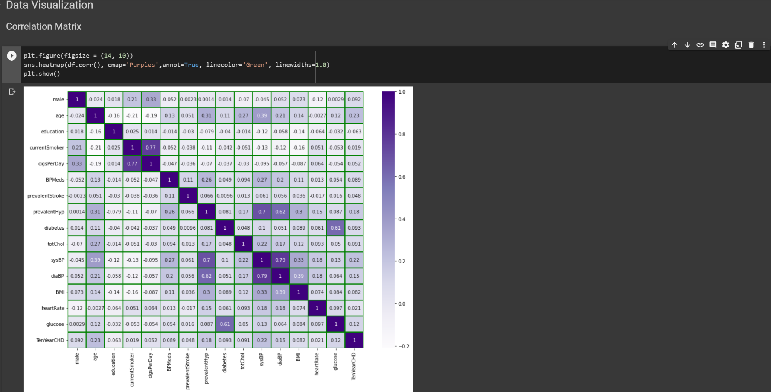

Slide 17
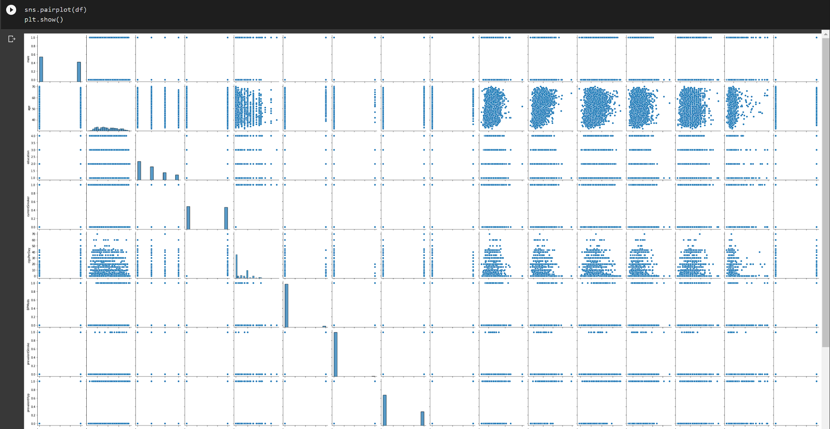

Slide 18
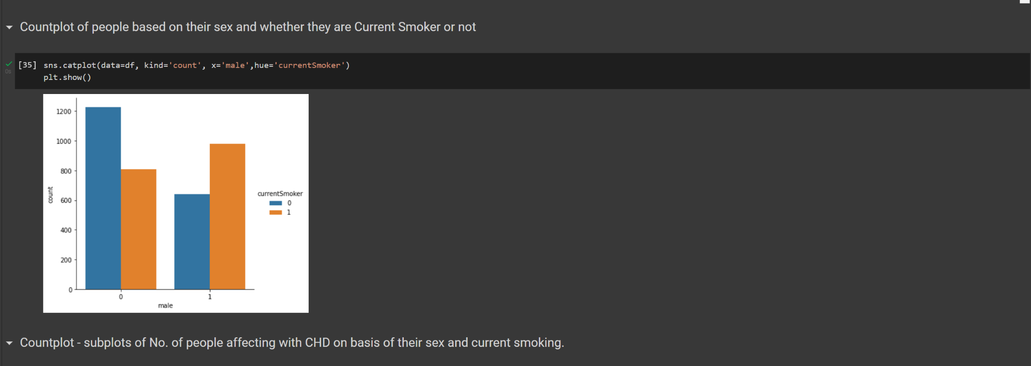
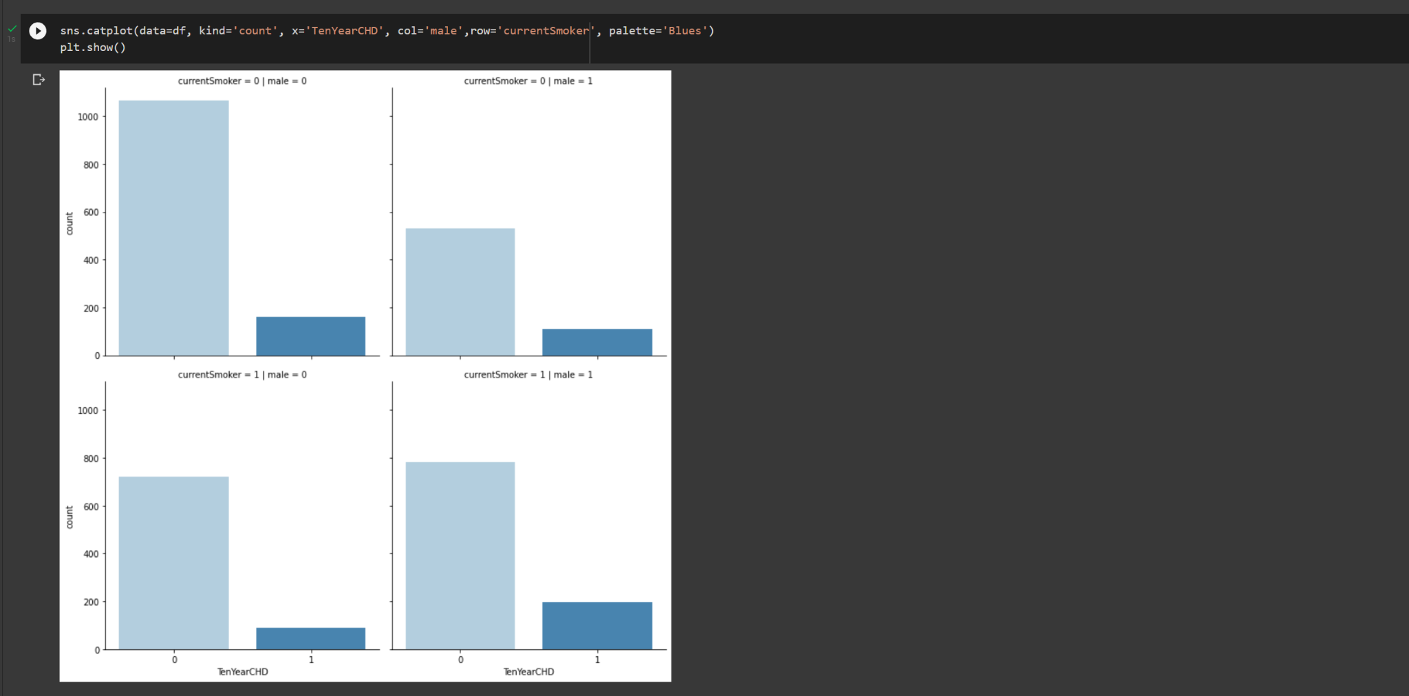

Slide 19
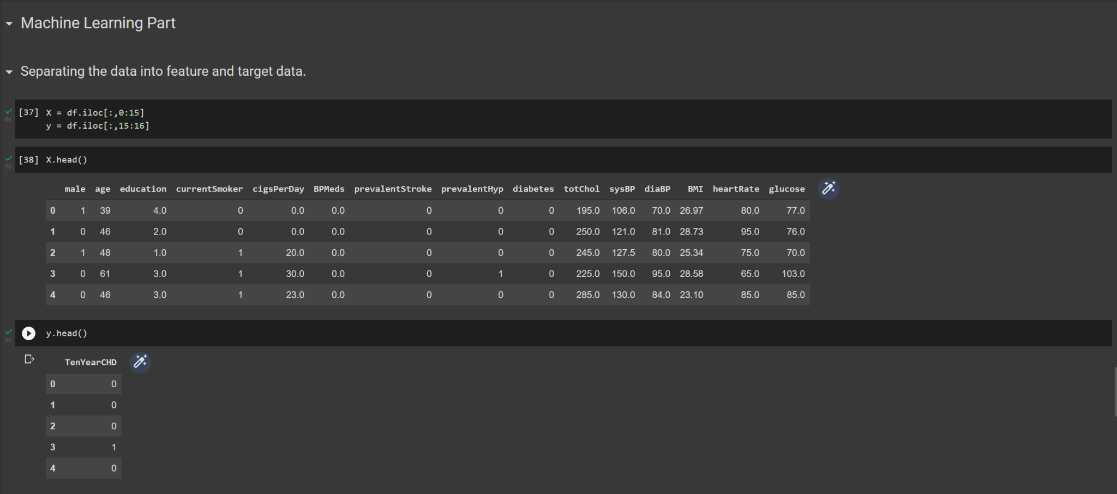

Slide 20
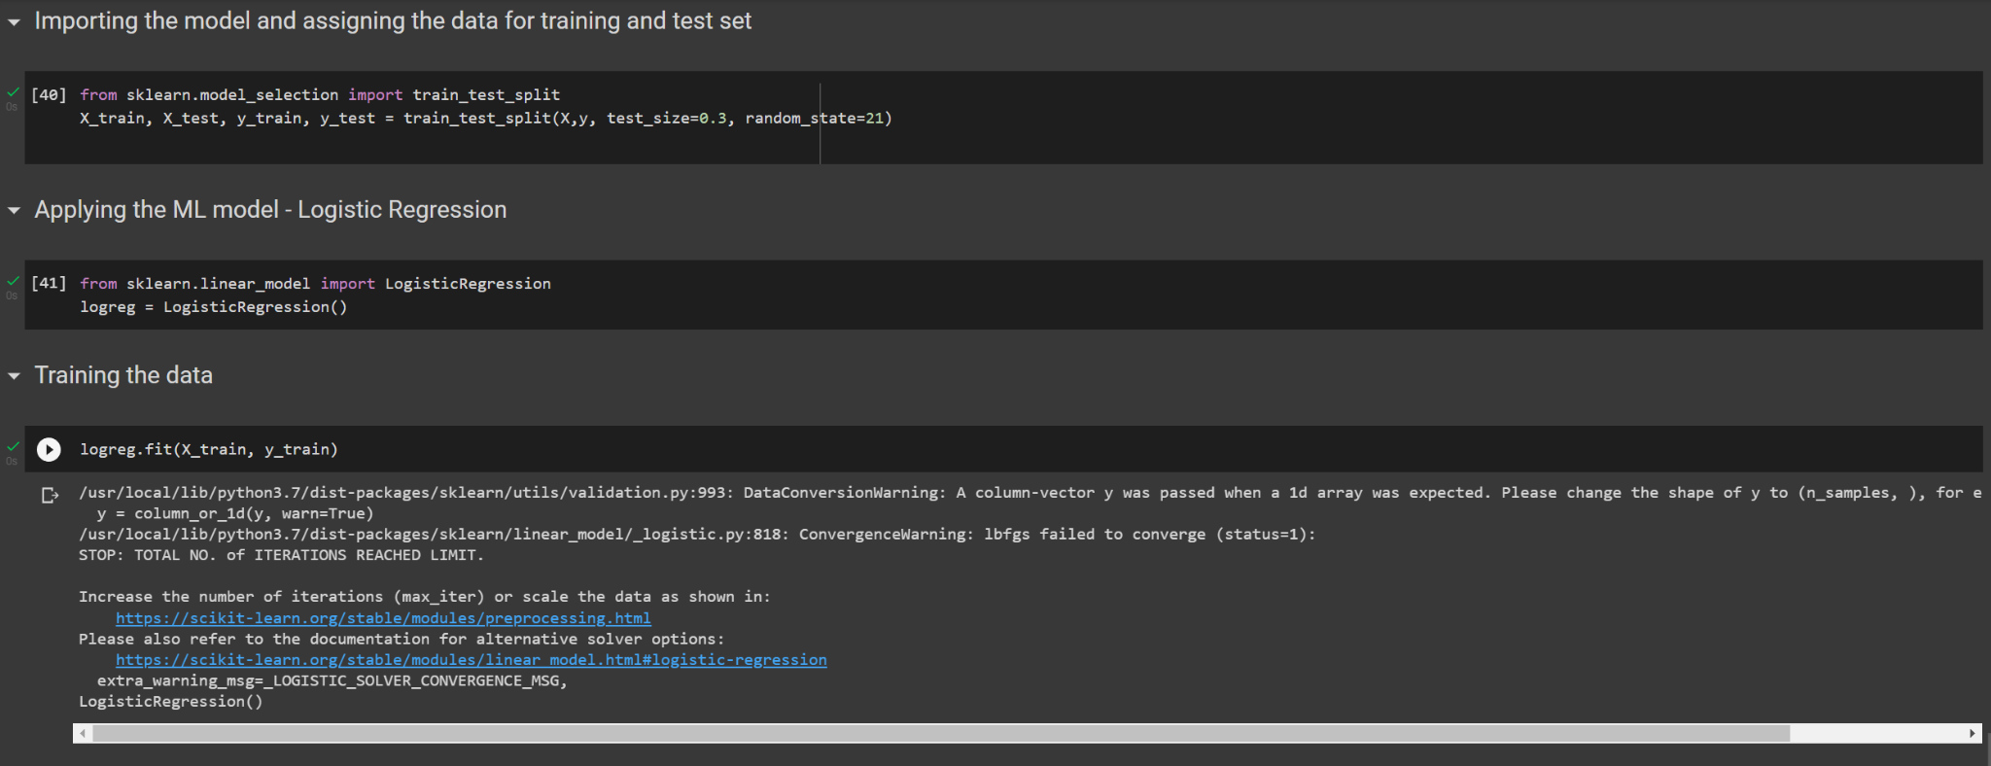

Slide 21
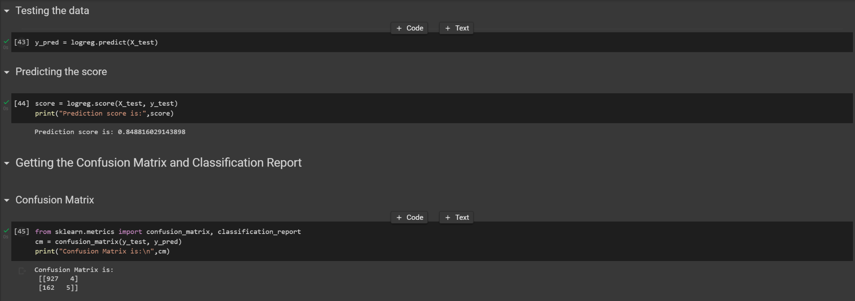
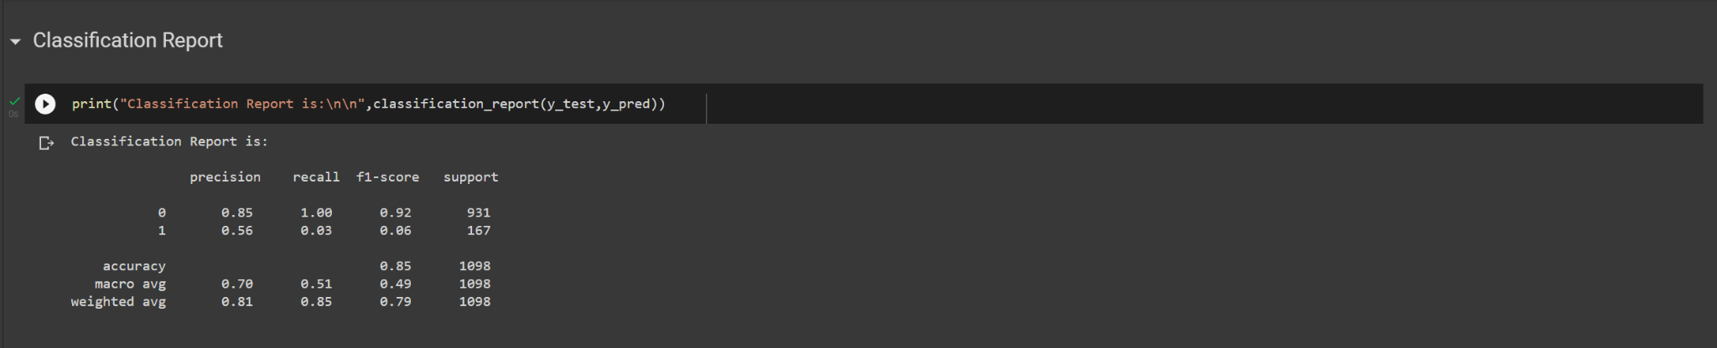

Slide 22
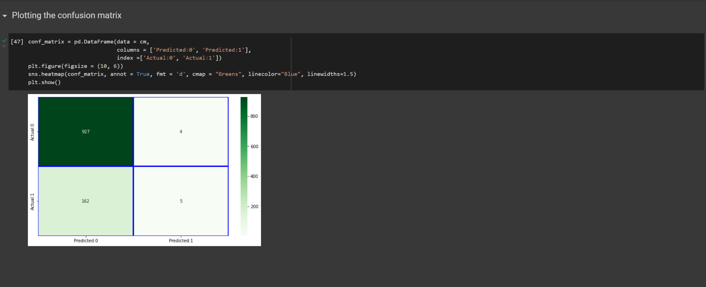

Slide 23
THANK YOU!

